Slide 1

Functions
TUIT
C++ Programming, Fall 2016
Lecture #6

Slide 2
TUIT
Roadmap
Last week we covered
Loops
This week we will learn
Introduction
Defining a Function
Calling a Function
void Functions
Passing Arguments by Value
Modularizing Code
Overloading Functions
Function Prototypes
Default Arguments
Inline Functions
Local, Global, and Static Local Variables
Passing Arguments by Reference
Constant Reference Parameters
Case Study: Converting Hexadecimals to Decimals
Function Abstraction and Stepwise Refinement

Slide 3
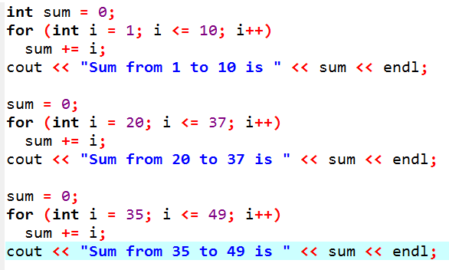
TUIT
Introduction
Functions can be used to define reusable code and organize and simplify code.
Suppose that you need to find the sum of integers from 1 to 10, from 20 to 37, and from 35 to 49, respectively. You may write the code as follows:

Slide 4
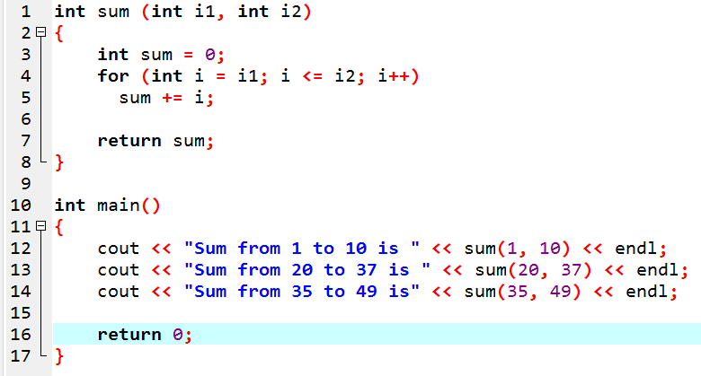
TUIT
Introduction
The preceding code can be simplified as follows:

Slide 5
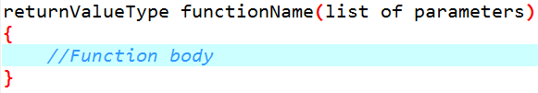
TUIT
Defining a Function
A function definition consists of its function name, parameters, return value type, and body.
The syntax for defining a function is as follows:

Slide 6
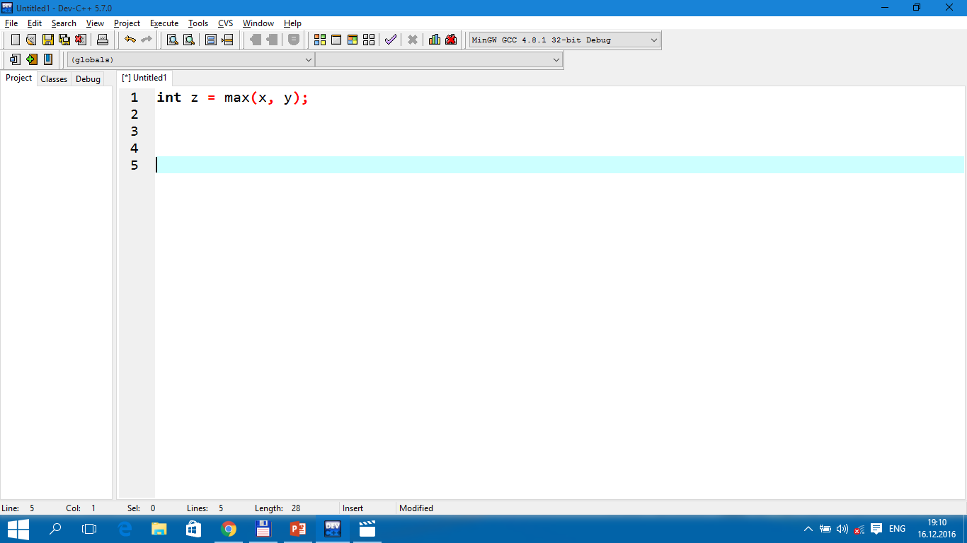
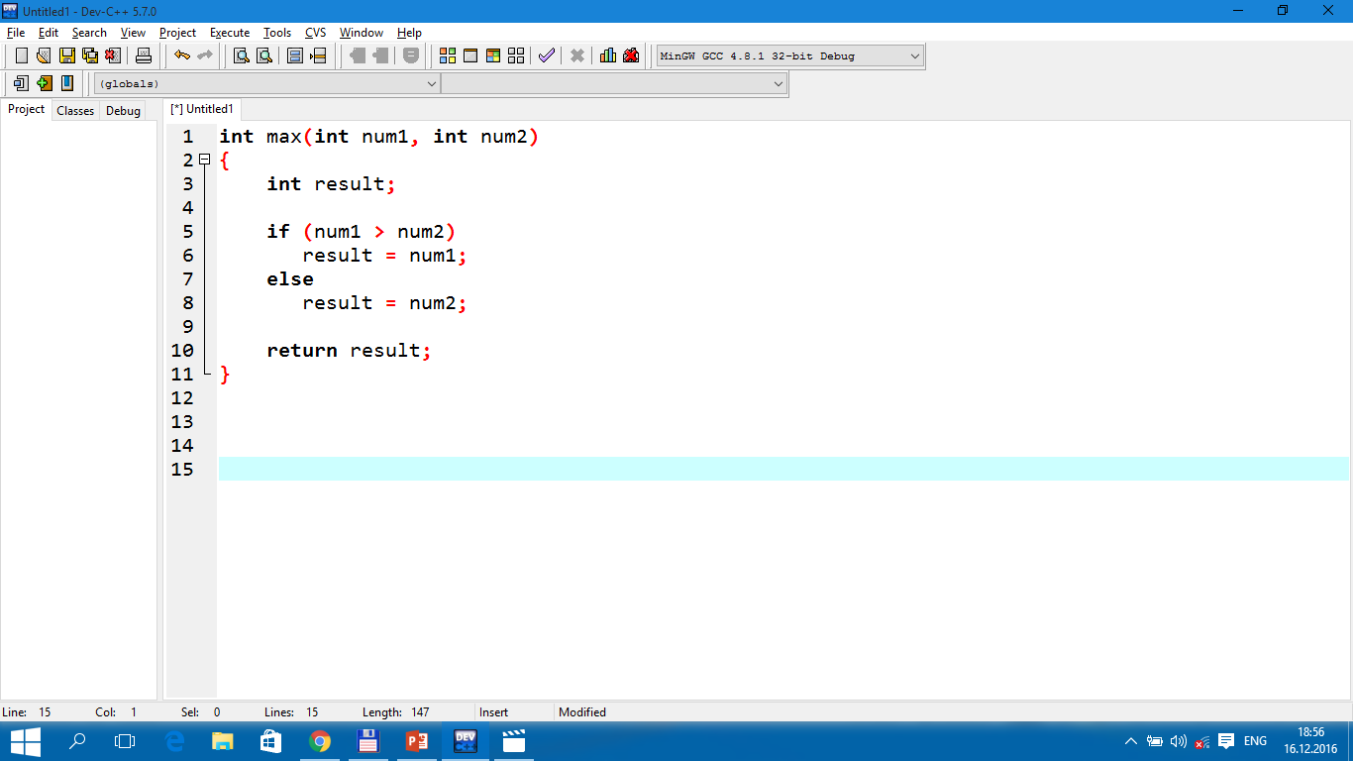
TUIT
Defining a Function
return value type
function name
formal parameters
actual parameters
(arguments)
parameter list
function
signature
function body
return value

Slide 7
TUIT
Caution
In the function header, you need to declare each parameter separately. For instance, max(int num1, int num2) is correct, but max(int num1, num2) is wrong.

Slide 8
TUIT
Calling a Function
Calling a function executes the code in the function.
If the function returns a value, a call to that function is usually treated as a value. For example,
int larger = max(3, 4);
calls max(3, 4) and assigns the result of the function to the variable. Another example of such a call is
cout << max(3, 4);
which prints the return value of the function call max(3, 4).

Slide 9
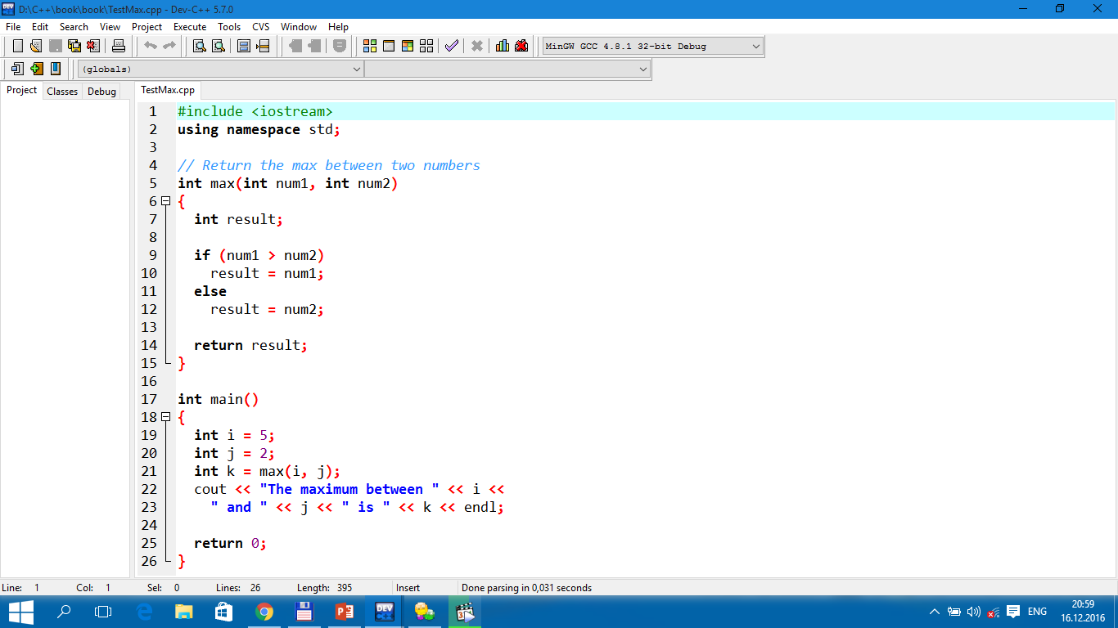

TUIT
Calling a Function
The maximum between 5 and 2 is 5

Slide 10
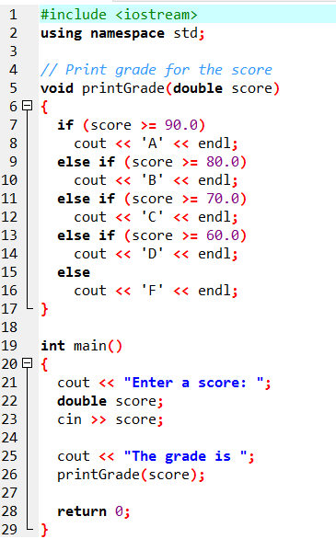

TUIT
void Functions
A void function does not return a value.
Enter a score: 78.5 The grade is C

Slide 11
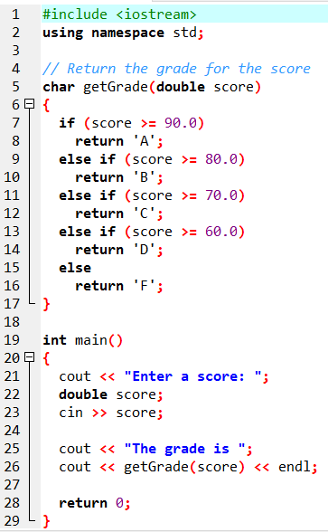
TUIT
void Functions
Translate Return Grade Function
Enter a score: 78.5 The grade is C

Slide 12
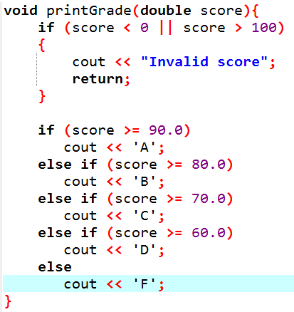
TUIT
Note
A return statement is not needed for a void function, but it can be used for terminating the function and returning control to the function’s caller. The syntax is simply
return;
This is rare but sometimes is useful for circumventing the normal flow of control in a void function. For example, the following code has a return statement to terminate the function when the score is invalid.

Slide 13
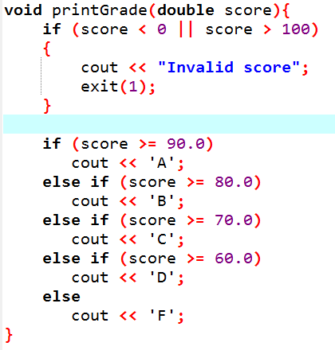
TUIT
Note
Occasionally you may need to terminate the program from the function immediately if an abnormal condition occurs. This can be done by invoking the exit(int) function defined in the cstdlib header. You can pass any integer to invoke this function to indicate an error in the program. For example, the following function terminates the program if an invalid score is passed to the function.

Slide 14
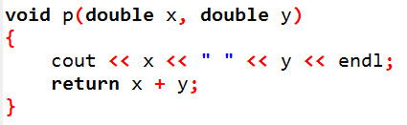
TUIT
Check Point
Does the return statement in the following function cause syntax errors?

Slide 15
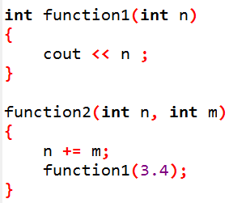
TUIT
Check Point
Identify and correct the errors in the following program:

Slide 16
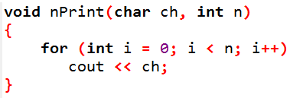
TUIT
Passing Arguments by Value
By default, the arguments are passed by value to parameters when invoking a function.
You can use nPrint(‘a’, 3) to print ‘a’ three times.

Slide 17
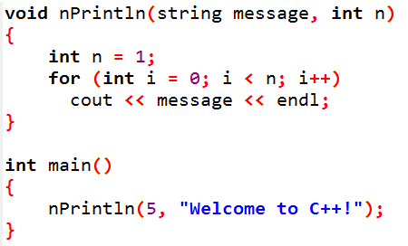
TUIT
Check Point
Identify and correct the errors in the following program:

Slide 18
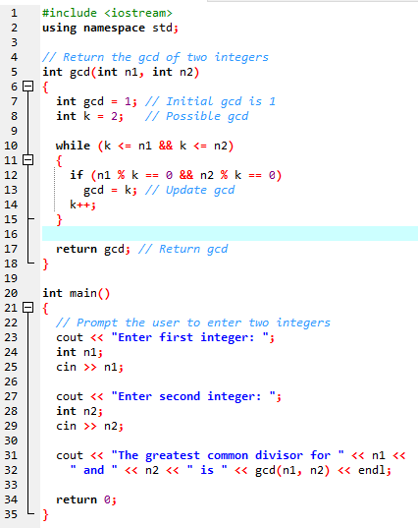
TUIT
Modularizing Code
Modularizing makes the code easy to maintain and debug and enables the code to be reused.
Enter first integer: 45 Enter second integer: 75 The greatest common divisor for 45 and 75 is 15

Slide 19
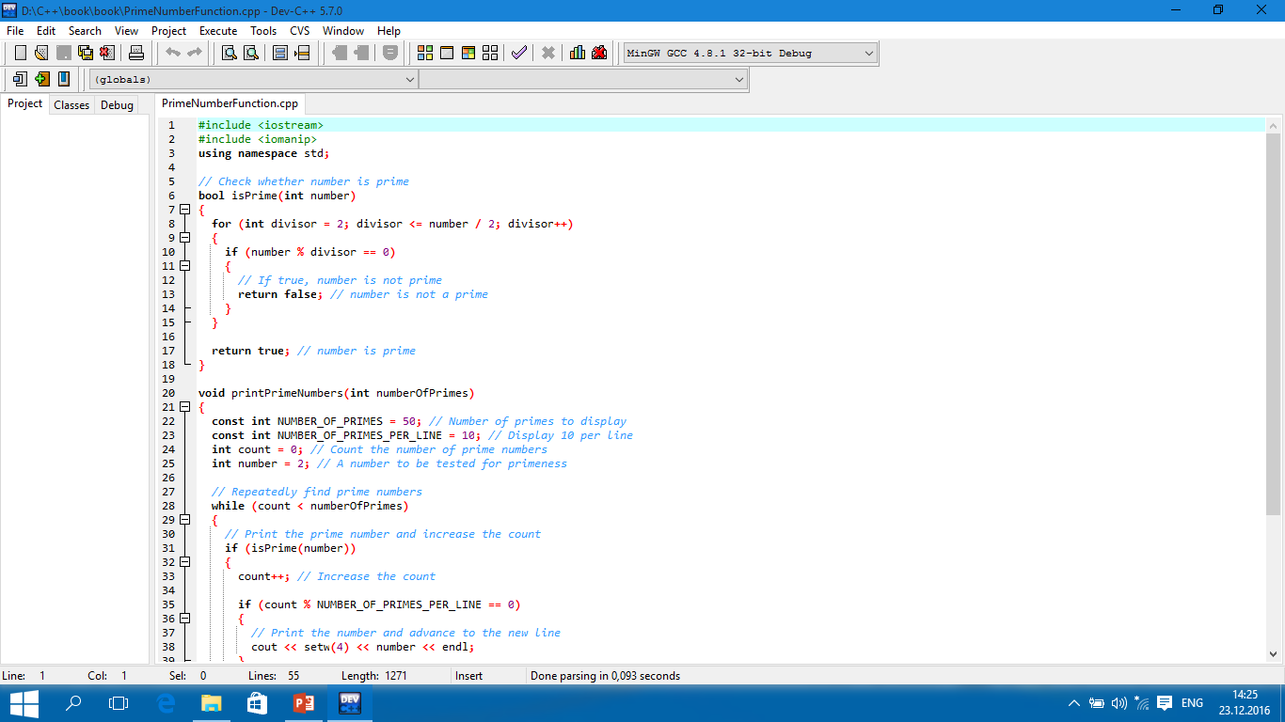
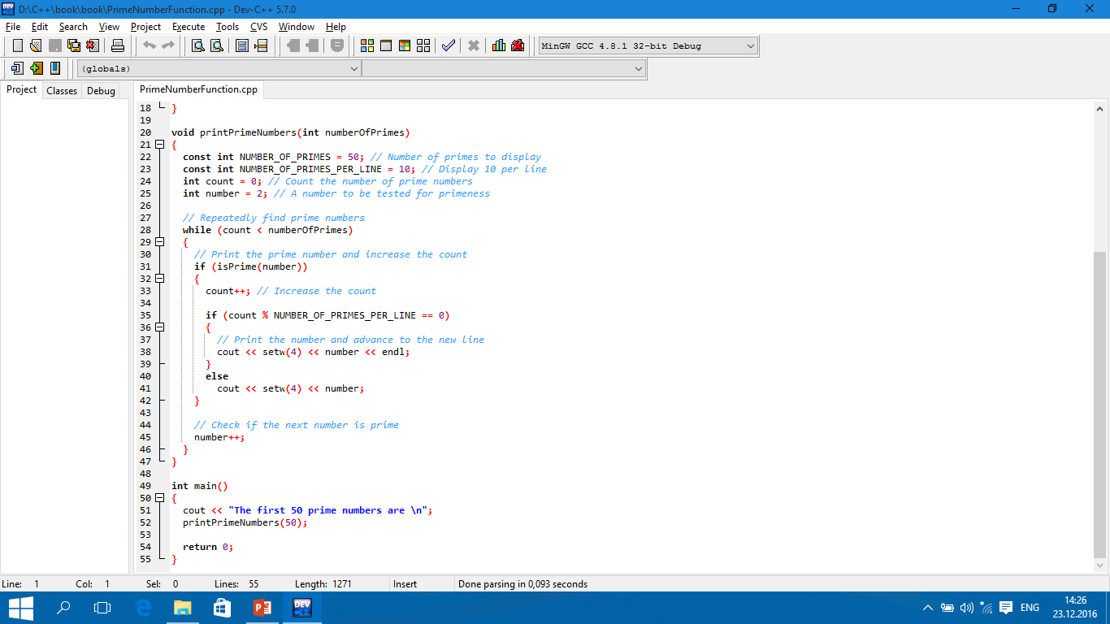
TUIT
Prime Number Function
The first 50 prime numbers are 2 3 5 7 11 13 17 19 23 29 31 37 41 43 47 53 59 61 67 71 73 79 83 89 97 101 103 107 109 113 127 131 137 139 149 151 157 163 167 173 179 181 191 193 197 199 211 223 227 229

Slide 20
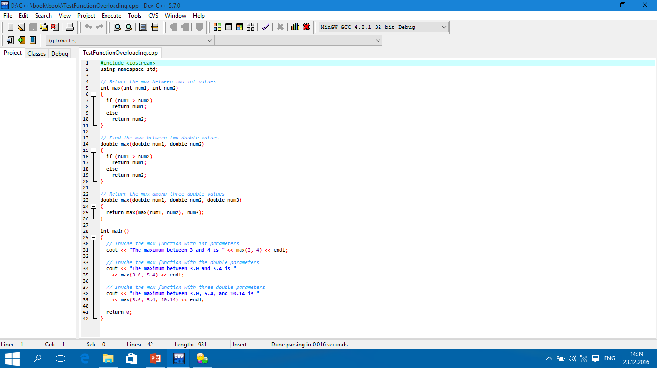
TUIT
Overloading Functions
Overloading functions enables you to define the functions with the same name as long as their signatures are different.
The maximum between 3 and 4 is 4 The maximum between 3.0 and 5.4 is 5.4 The maximum between 3.0, 5.4, and 10.14 is 10.14

Slide 21
TUIT
Tip
Overloading functions can make programs clearer and more readable. Functions that perform the same task with different types of parameters should be given the same name.

Slide 22
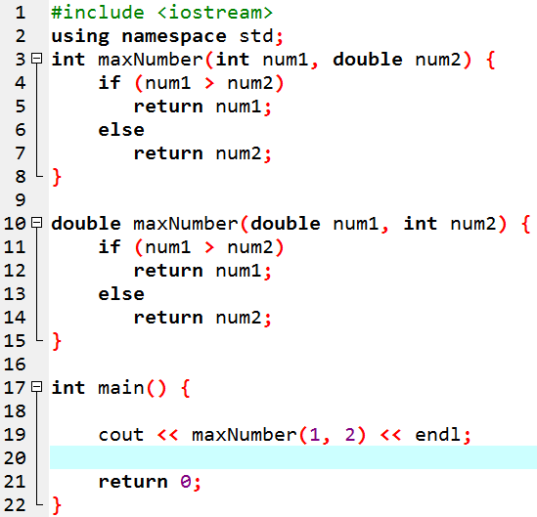
TUIT
Note
Overloaded functions must have different parameter lists. You cannot overload functions based on different return types.

Slide 23
TUIT
Caution
Math functions are overloaded in the <cmath> header file. For example, there are three overloaded functions for sin:
float sin(float)
double sin(double)
long double sin(long double)

Slide 24
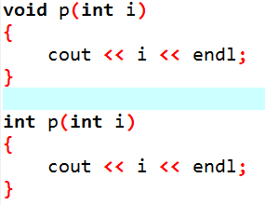
TUIT
Check Point
What is wrong in the following program?

Slide 25
TUIT
Check Point
Given two function definitions,
double m(double x, double y)
double m(int x, int y)
Answer the following questions:
double z = m(4, 5);
double z = m(4, 5.4);
double z = m(4.5, 5.4);

Slide 26
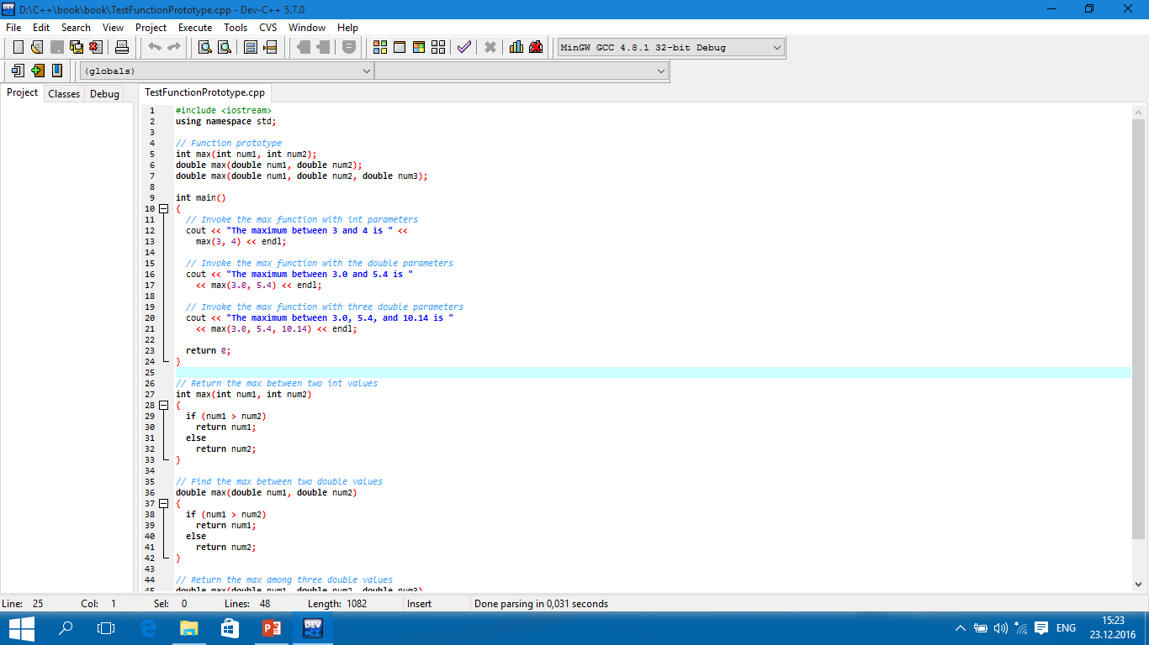
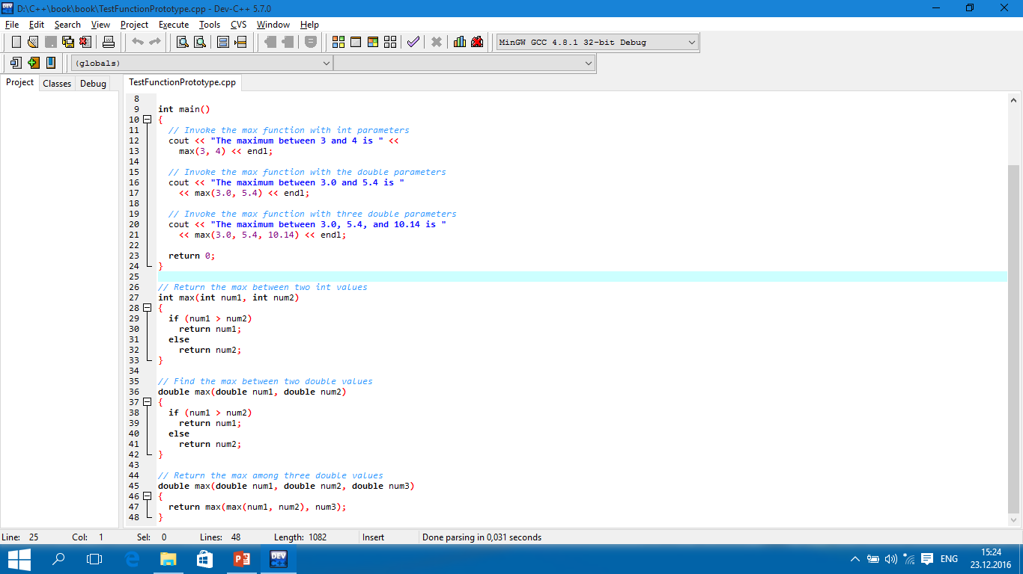
TUIT
Function Prototypes
A function prototype declares a function without having to implement it.

Slide 27
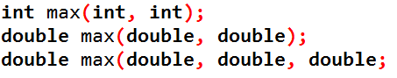
TUIT
Tip
In the prototype, you need not list the parameter names, only the parameter types. C++ compiler ignores the parameter names. The prototype tells the compiler the name of the function, its return type, the number of parameters, and each parameter’s type. So lines 5 – 7 can be replaced by

Slide 28
TUIT
Note
We say “define a function” and “declare a function”. Declaring a function specifies what a function is without implementing it. Defining a function gives a function body that implements the function.

Slide 29
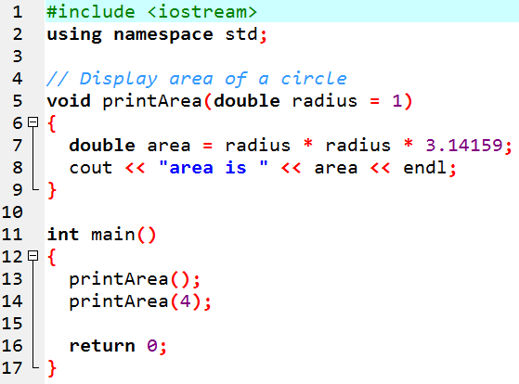
TUIT
Default Arguments
You can define default values for parameters in a function.
area is 3.14159 area is 50.2654

Slide 30
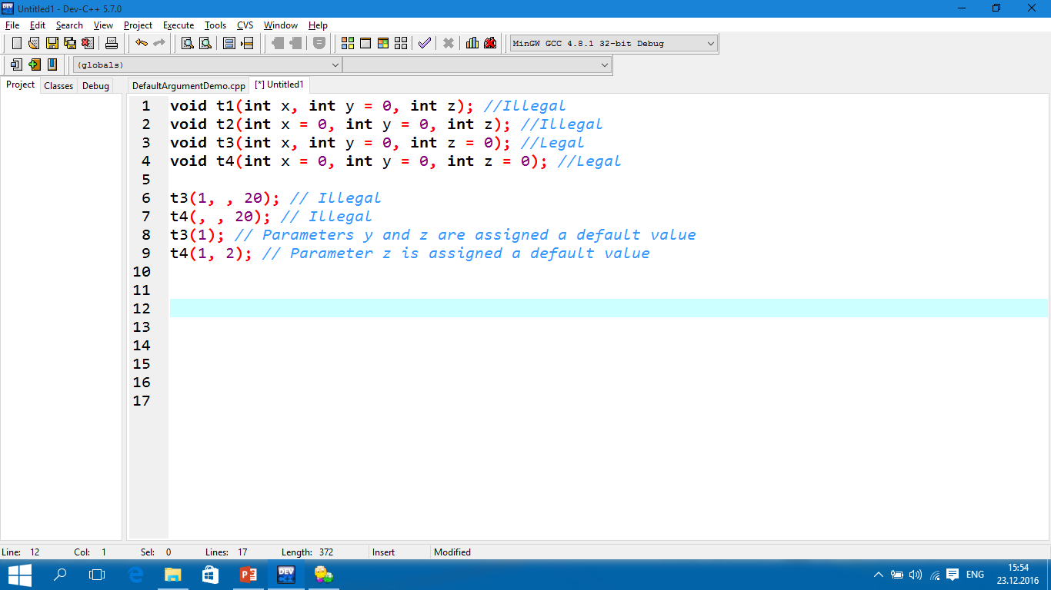
TUIT
Default Arguments
You can define default values for parameters in a function.

Slide 31
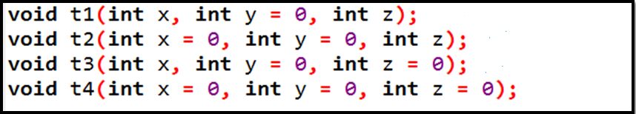
TUIT
Check Point
Which of the following function declarations are illegal?

Slide 32
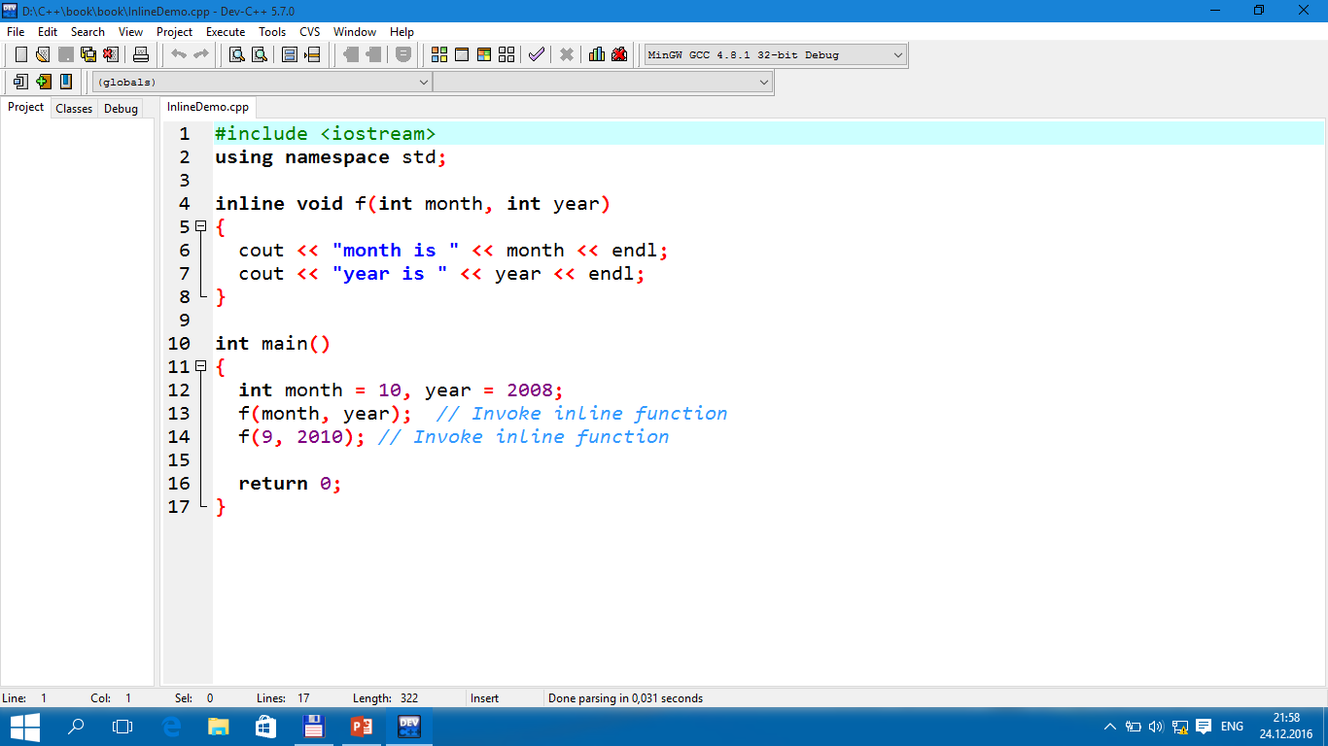
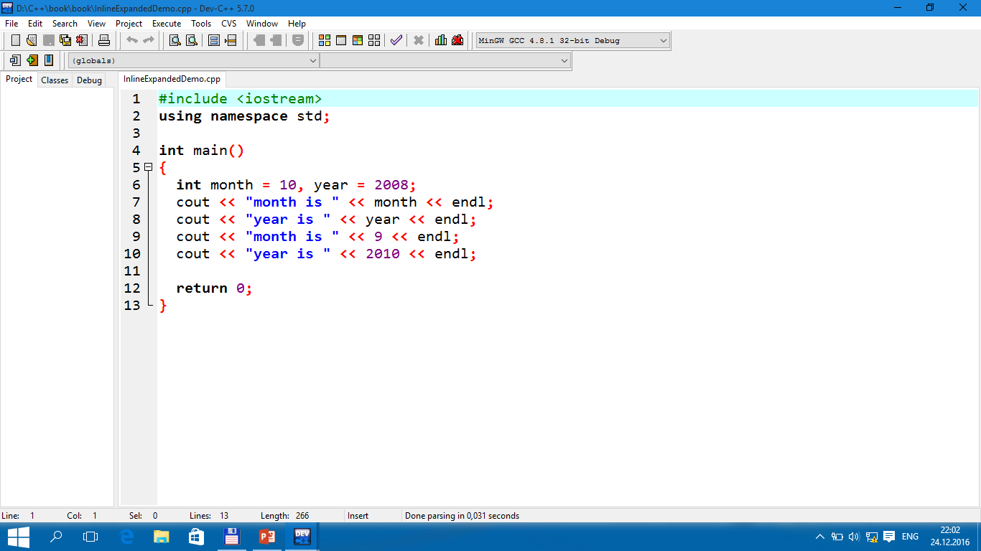
TUIT
Inline Functions
C++ provides inline functions for improving performance for short functions.
Inline function expanded
month is 10 year is 2008 month is 9 year is 2010

Slide 33
TUIT
Local, Global, and Static Local Variables
A variable can be declared as a local, a global, or a static local in C++. A variable defined inside a function is referred to as a local variable. C++ also allows you to use global variables. They are declared outside all functions and are accessible to all functions in their scope. Local variables do not have default values, but global variables are defaulted to zero. A variable must be declared before it can be used. The scope of a local variable starts from its declaration and continues to the end of the block that contains the variable. The scope of a global variable starts from its declaration and continues to the end of the program.

Slide 34
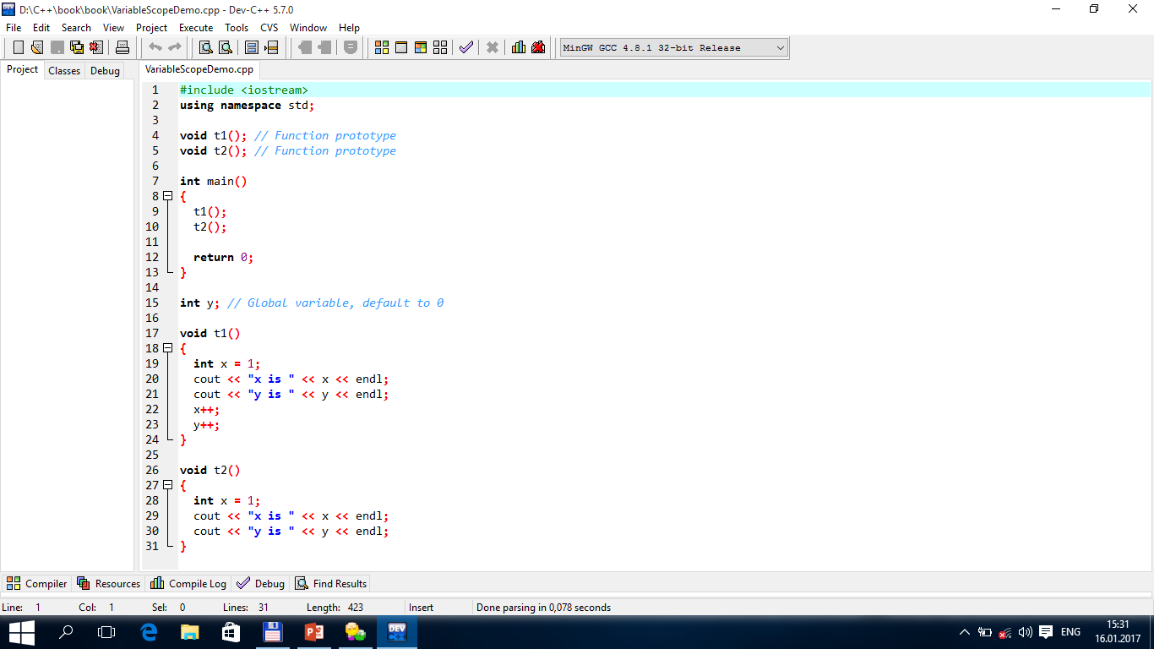
TUIT
Local, Global, and Static Local Variables
x is 1 y is 0 x is 1 y is 1

Slide 35
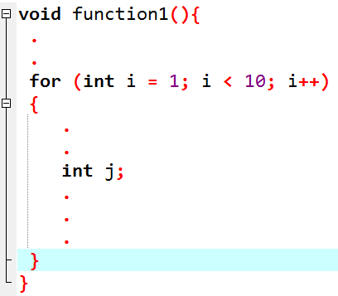
TUIT
The Scope of Variables in a for Loop
A variable declared in the initial-action part of a for-loop header has its scope in the entire loop.
The scope of i
The scope of j

Slide 36
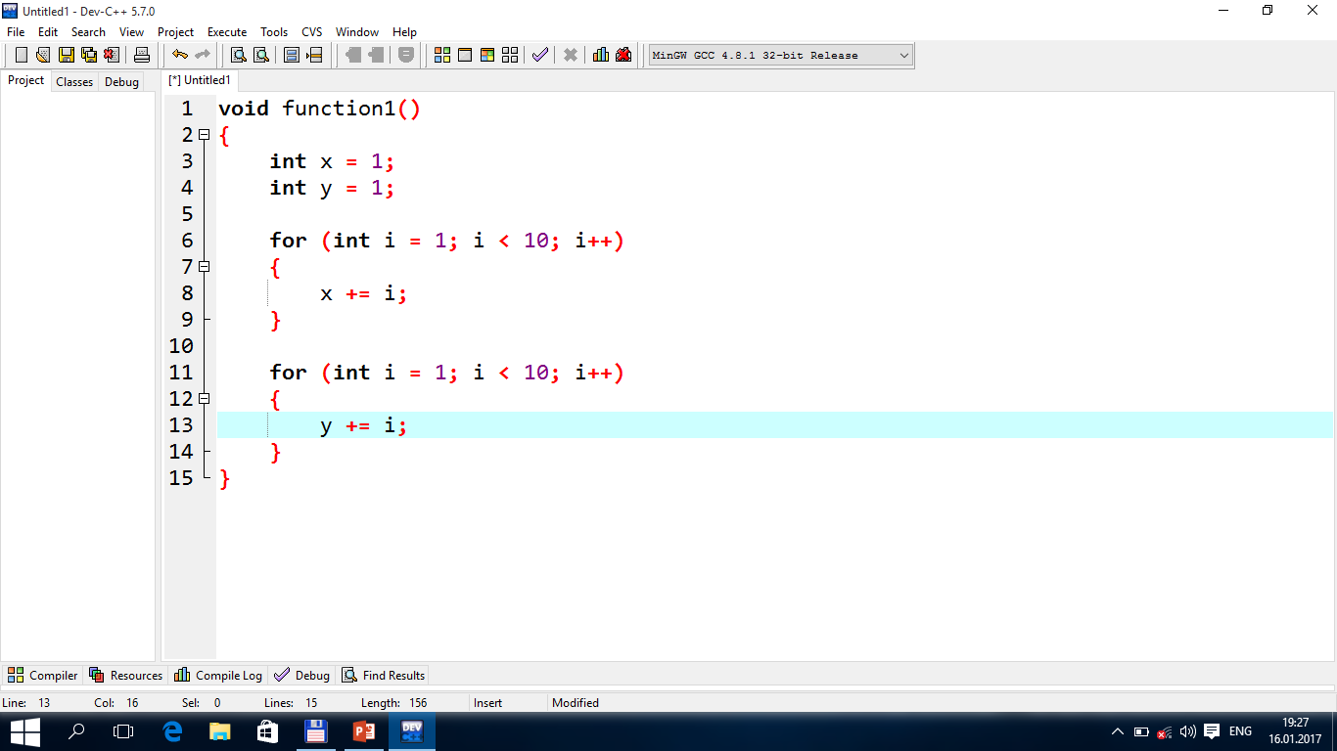
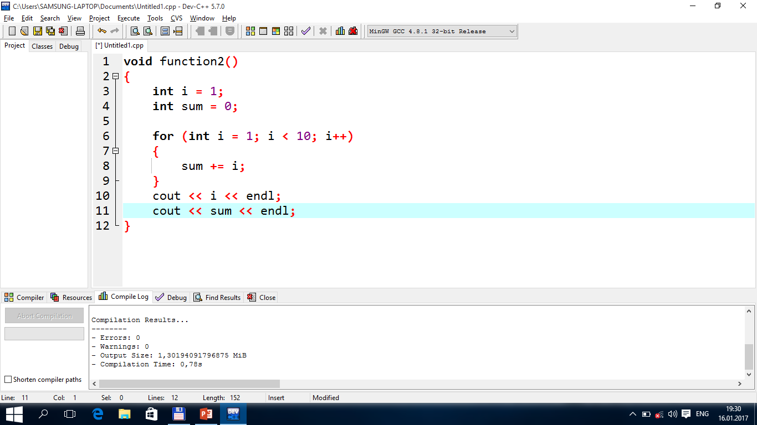
TUIT
The Scope of Variables in a for Loop
It is fine declare i in two nonnesting blocks
It is not a good practice to declare i in two nesting blocks

Slide 37
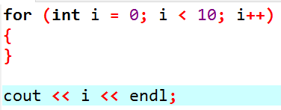
TUIT
Caution
Do not declare a variable inside a block and then attempt to use it outside the block. Here is an example of a common mistake:

Slide 38
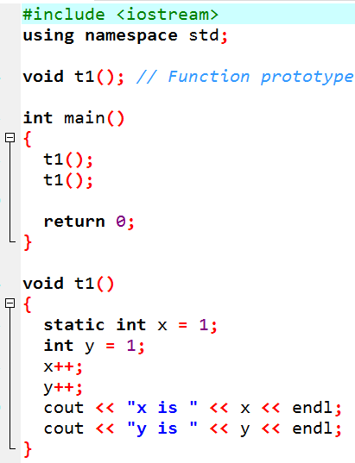
TUIT
Static Local Variables
After a function completes its execution, all its local variables are destroyed. Static local variables are permanently allocated in the memory for the life time of the program. To declare a static variable, use the keyword static.
x is 2 y is 2 x is 3 y is 2

Slide 39
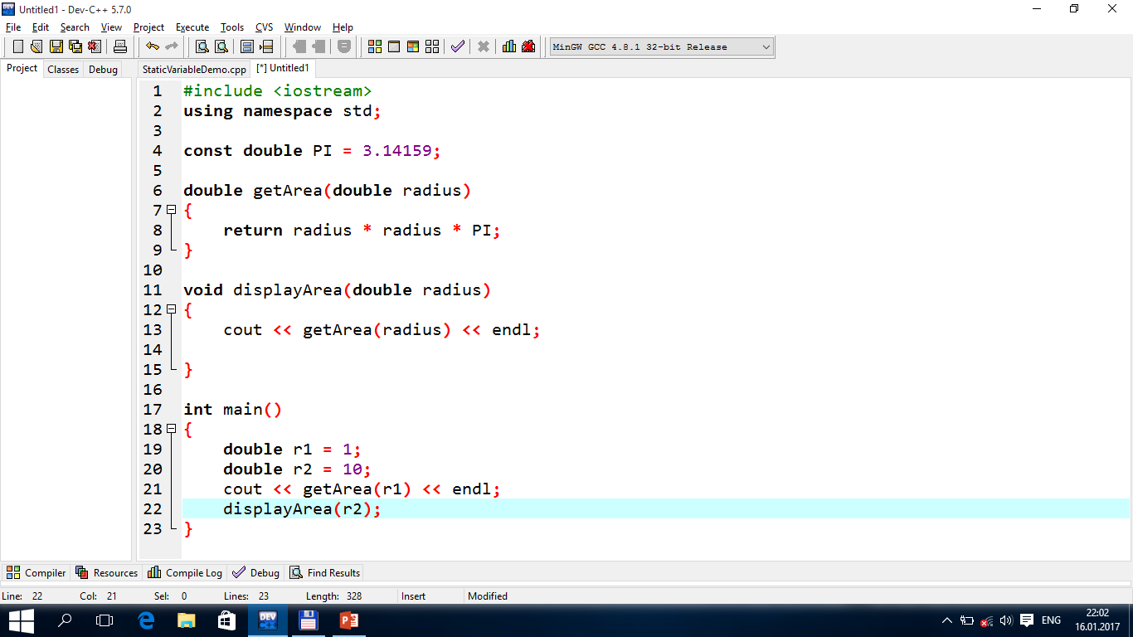
TUIT
Check Point
Show the output of the following code:

Slide 40
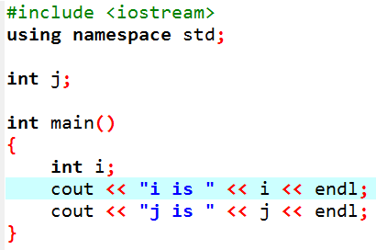
TUIT
Check Point
Identify global and local variables in the following program:

Slide 41
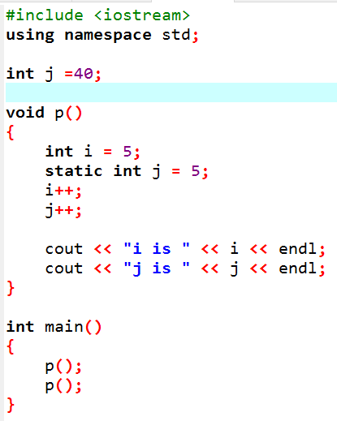
TUIT
Check Point
Identify global variables, local variables, and static local variables in the following program. What will be the output of the code?

Slide 42
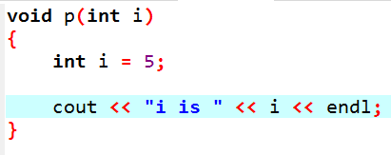
TUIT
Check Point
Identify and correct the errors in the following program:

Slide 43
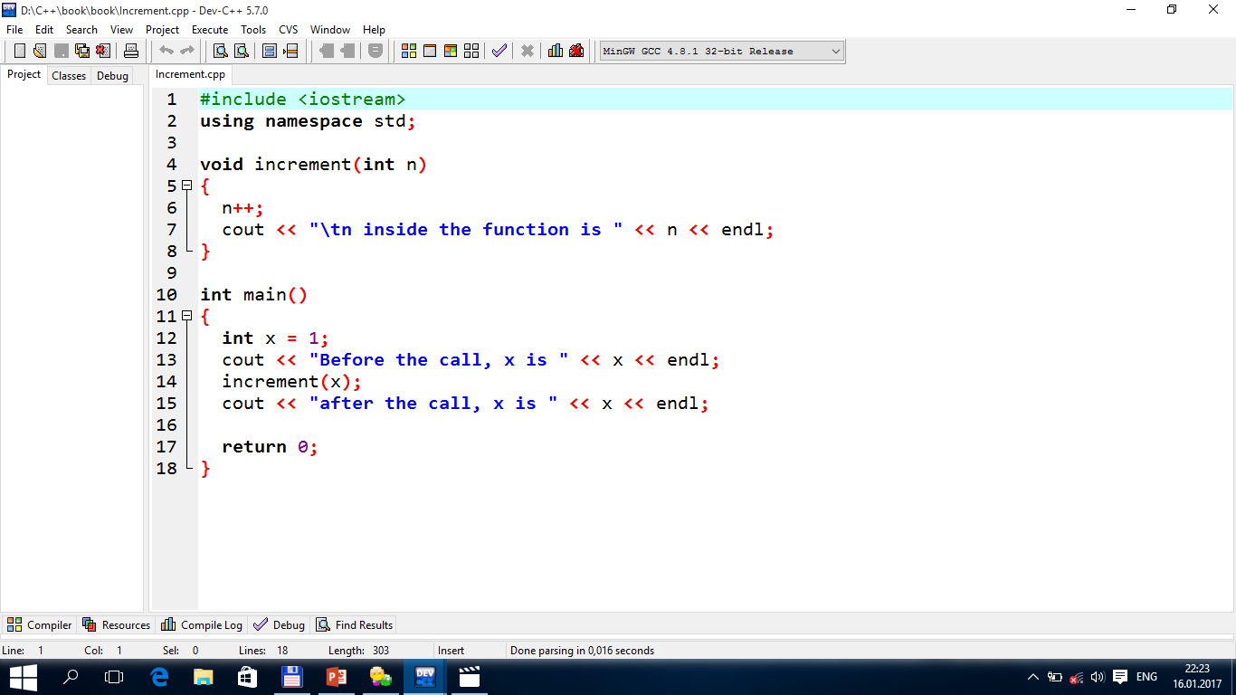
TUIT
Passing Arguments by Reference
Parameters can be passed by reference, which makes the formal parameter an alias of the actual argument. Thus, changes made to the parameters inside the function also made to the arguments.
Before the call, x is 1 n inside the function is 2 after the call, x is 1

Slide 44
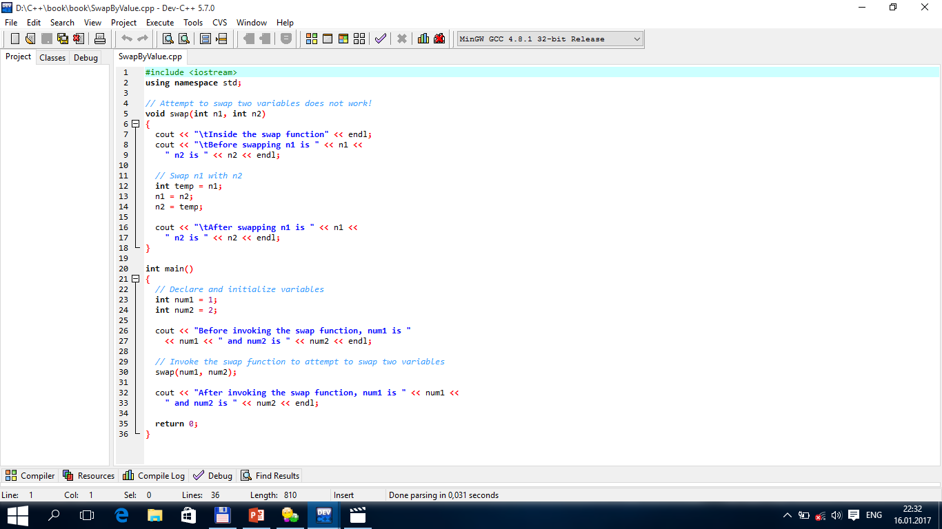
TUIT
Passing Arguments by Reference
Before invoking the swap function, num1 is 1 and num2 is 2 Inside the swap function Before swapping n1 is 1 n2 is 2 After swapping n1 is 2 n2 is 1 After invoking the swap function, num1 is 1 and num2 is 2

Slide 45
TUIT
Passing Arguments by Reference
So, can we write a function to swap two variables? Yes. The function can accomplish this by passing a reference to the variables. C++ provides a special type of variable – a reference variable – which can be used as a function parameter to reference the original variable. To declare a reference variable, place the ampersand (&) in front of the variable or after the data type for the variable. For example, the following code declares a reference variable r that refers to variable count.
int &r = count or int& r = count or int & r = count

Slide 46
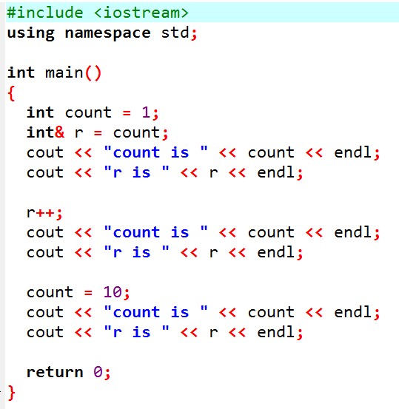
TUIT
Passing Arguments by Reference
count is 1 r is 1 count is 2 r is 2 count is 10 r is 10
count
1
count
2
r
r
(a)
(b)

Slide 47
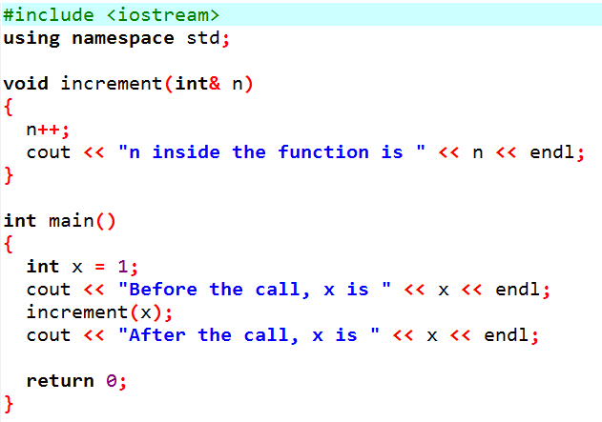
TUIT
Increment with pass by Reference
Before the call, x is 1 n inside the function is 2 After the call, x is 2

Slide 48
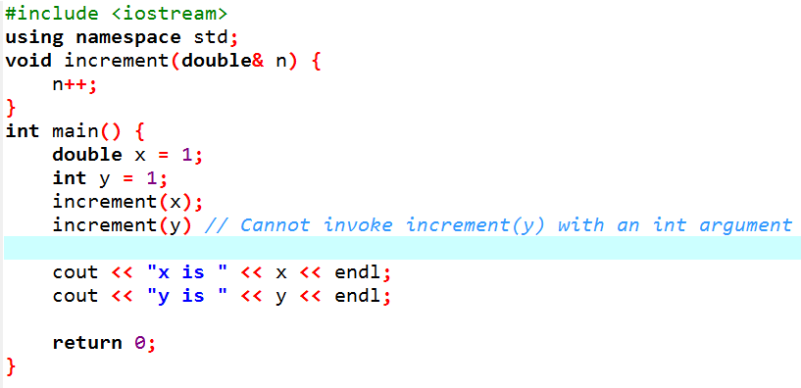
TUIT
Passing Arguments by Reference

Slide 49
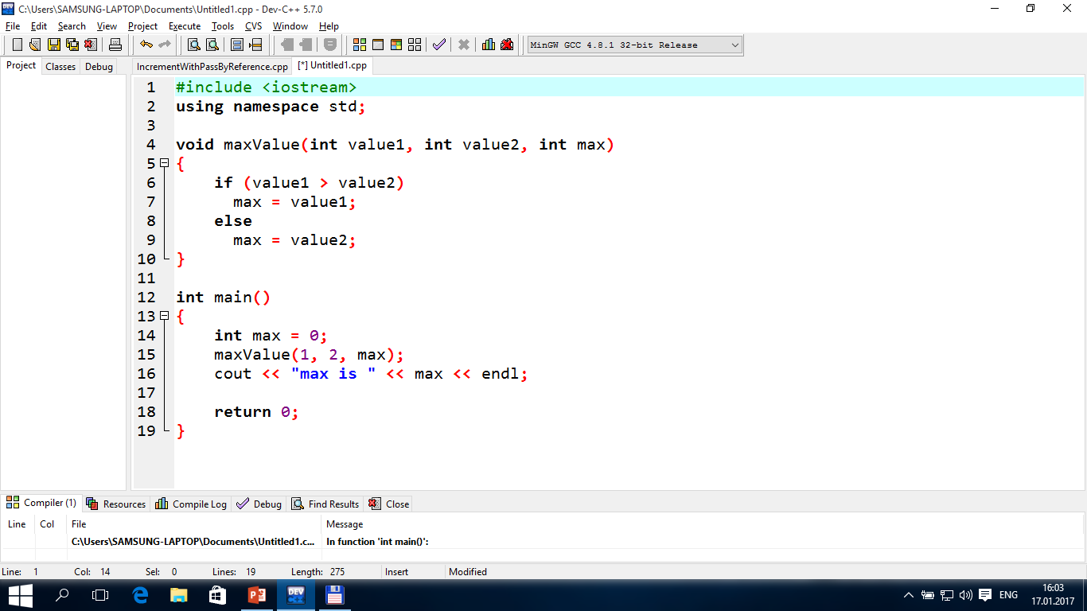
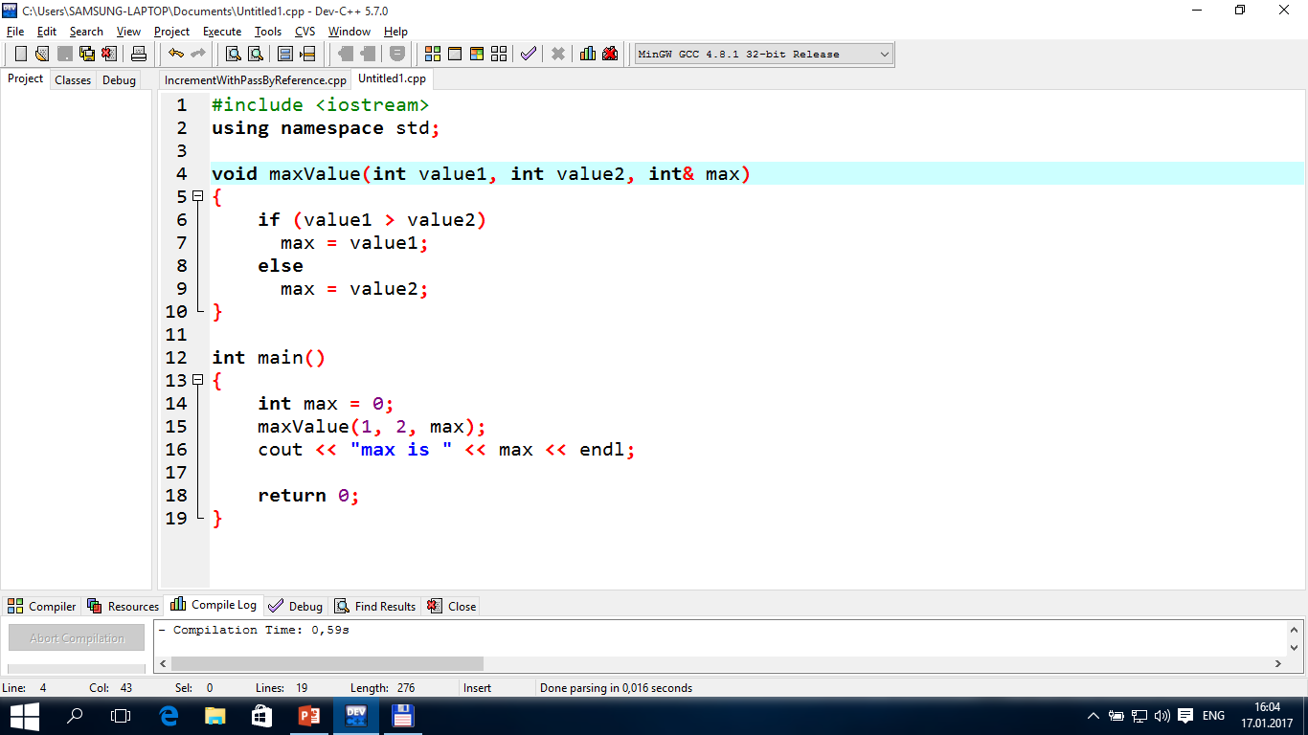
TUIT
Check Point
What is pass-by-value? What is pass-by-reference? Show the result of the following programs:

Slide 50
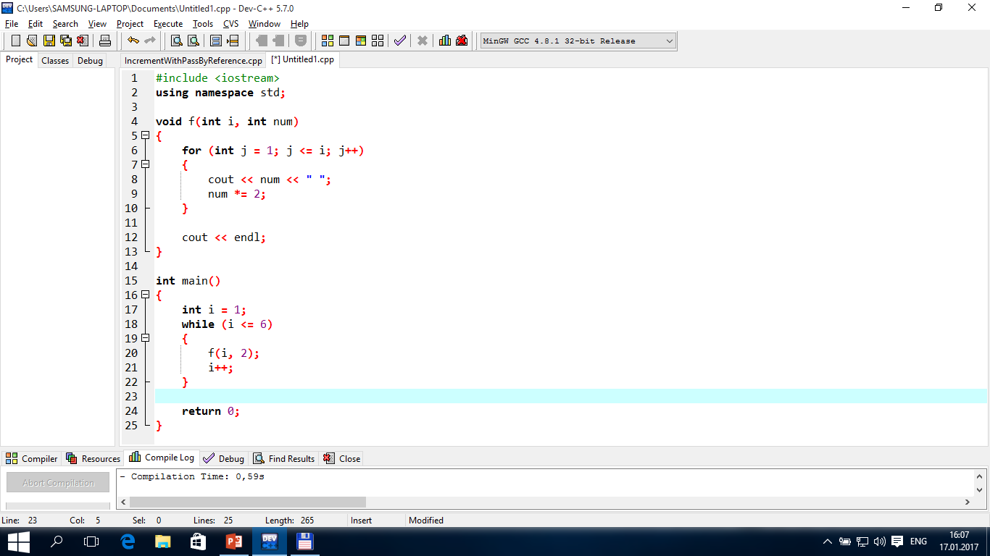
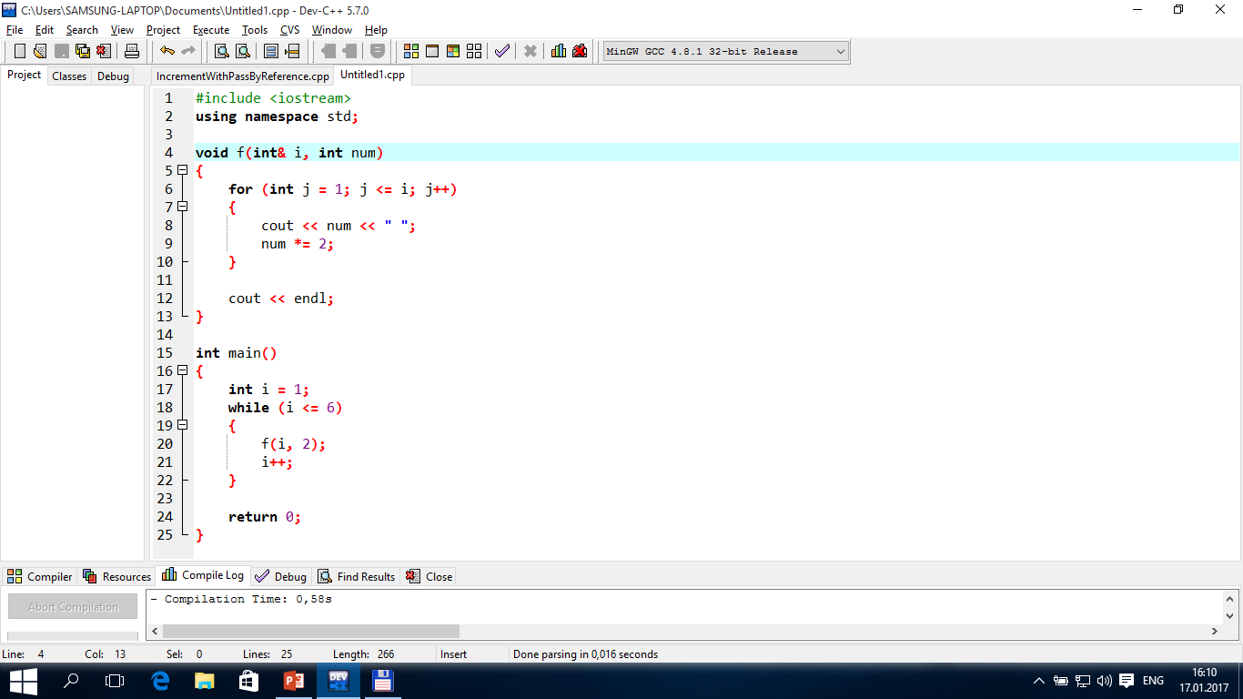
TUIT
Check Point

Slide 51
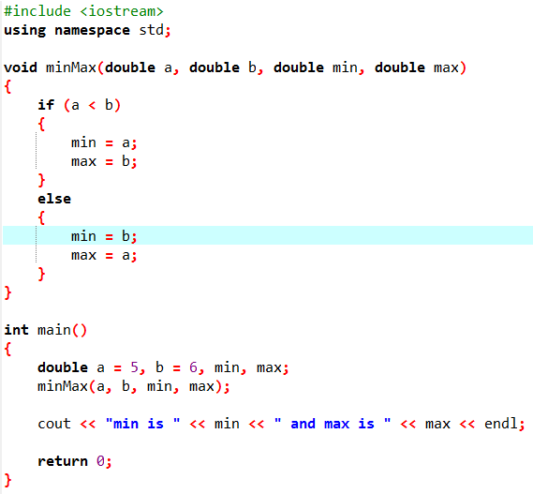
TUIT
Check Point
A student wrote the following function to find the minimum and maximum number between two values a and b. What is wrong in the program?

Slide 52
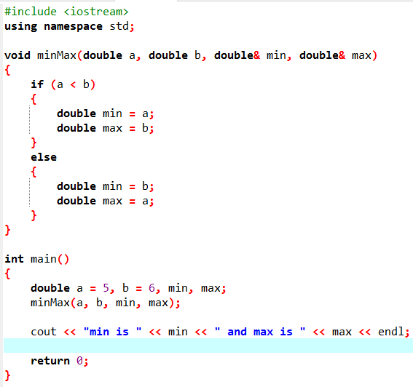
TUIT
Check Point
A student wrote the following function to find the minimum and maximum number between two values a and b. What is wrong in the program?

Slide 53
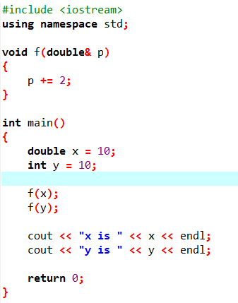
TUIT
Check Point
What is wrong in the following program?

Slide 54

TUIT
Constant Reference Parameters
You can specify a constant reference parameter to prevent its value from being changed by accident.

Slide 55

TUIT
Case Study: Converting Hexadecimals to Decimals
This section presents a program that converts a hexadecimal number into a decimal number.
Given a hexadecimal number $h_{n}h_{n−1}h_{n−2}…h_{2}h_{1}h_{0},$ the equivalent decimal value is $h_{n}×{16}^{n}+h_{n−1}×{16}^{n−1}+…+h_{0}×{16}^{0}$.
For example, the hex number AB8C is
$$10×{16}^{3}+11×{16}^{2}+8×{16}^{1}+12×{16}^{0}=43916$$

Slide 56

TUIT
Case Study: Converting Hexadecimals to Decimals
Enter a hex number: AB8C The decimal value for hex number AB8C is 43916
Enter a hex number: af71 The decimal value for hex number af71 is 44913

Slide 57
TUIT
Function Abstraction and Stepwise Refinement
The key to developing software is to apply the concept of abstraction.
Function abstraction is achieved by separating the use of a function from its implementation. The client can use a function without knowing how it is implemented. The implementation of the function is hidden from the client in a “black box”, as shown in following picture:
Optional arguments for input
Optional return value
Function Header
Function Body
Black Box
The function body can be thought of as a black box that contains the detailed implementation for the function

Slide 58
TUIT
Function Abstraction and Stepwise Refinement
You have already used the rand() function to return a random number, the time(0) function to obtain the current time, and the max function to find the maximum number. You know how to write the code to invoke these functions in your program, but as a user of these functions, you are not required to know how they are implemented.
The concept of function abstraction can be applied to the process of developing programs. When writing a large program, you can use the “divide-and-conquer” strategy, also known as stepwise refinement, to decomposed into smaller, more manageable ones.

Slide 59
TUIT
Function Abstraction and Stepwise Refinement
Suppose you write a program that displays the calendar for a given month of the year. The program prompts the user to enter the year and the month, and then displays the entire calendar for the month, as shown following:
Header
August 2013
Sun Mon Tue Wed Thu Fri Sat 1 2 3 4 5 6 7 8 9 10 11 12 13 14 15 16 17 18 19 20 21 22 23 24 25 26 27 28 29 30 31
Body

Slide 60
TUIT
Top-Down Design
How would you start such a program? Would you immediately start coding? Beginning programmers often start by trying to work out the solution to every detail. Although details are important in the final program, concern for detail in the early stages may block the problem-solving process. To make problem-solving flow smoothly, this example beings by using function abstraction to isolate from design; only later does it implement the details.

Slide 61
TUIT
Top-Down Design
For this example, the problem is first broken into two subproblems: get input from the user, and print the calendar for the month. At this stage, you should be concerned with what the subproblems will achieve, not with how to get input and print the calendar for the month. You can draw a structure chart to help visualize the decomposition of the problem:
printMonth
printMonthTitle
printMonthBody
printCalendar
(main)
readInput
printMonth

Slide 62
TUIT
Top-Down Design
You can use the cin object to read input for the year and the month. The problem of printing the calendar for a given month can be broken into two subproblems: print the month title, and print the month body. The month title consist of three lines: month and year, a dashed line, and the names of the seven days of the week. You need to get the month name (e.g., January) from the numeric month (e.g., 1). This is accomplished in printMonthName
printMonthBody
getStartDay
getNumberOfDaysInMonth
printMonthTitle
printMonthNamw

Slide 63
TUIT
Top-Down Design
How would you get the start day for a month? There are several ways to find it. Assume that you know that start day (startDay1800 = 3) for January 1, 1800, was Wednesday. You could compute the total number of days (totalNumberOfDays) between January 1, 1800, and the start day of the calendar month. The computation is (totalNumberOfDays + startDay1800) % 7, because every week has seven days. So the getStartDay problem can be further refined as getTotalNumberOfDays, as shown:
getStartDay
getTotalNumberOfDays

Slide 64
TUIT
Top-Down Design
To get the total number of days, you need to know whether a year is a leap year and how many days are in each month. So getTotalNumberOfDays is further refined into two subproblems: isLeapYear and getNumberOfDaysInMonth, as shown following:
getTotalNumberOfDays
getTotalNumberOfDaysInMonth
isLeapYear

Slide 65
TUIT
Top-Down Design
printCalendar
(main)
readInput
printMonth
printMonthTitle
printMonthBody
printMonthName
getStartDay
getTotalNumberOfDays
getNumberOfDaysInMonth
isLeapYear
The structure chart shows the hierarchical relationship of the subproblems in the program.

Slide 66
TUIT
Top-Down or Bottom-Up Implementation
Now we turn our attention to implementation. In general, a subproblem corresponds to a function in the implementation, although some subproblems are so simple that this is unnecessary. You must decide which modules to implement as functions and which to combine in other functions. Such decisions should be based on whether the overall program will be easier to read because of your choice. In this example, the subproblem readInput can be simply implemented in the main function.

Slide 67
TUIT
Top-Down or Bottom-Up Implementation
You can use either a “top-down” or a “buttom-up” implementation. The top-down approach implements one function at a time in the structure chart from top to bottom. Stubs can be used for the functions waiting to be implemented. A stub is a simple, but incomplete, version of a function. Usually a stub displays a test message indicating that it was called, and nothing more. The use of stubs enables you to test invoking the function from a caller. Implement the main function first, then use a stub for the printMonth function. For example, let printMonth display the year and the month in the stub.

Slide 68

TUIT
Top-Down or Bottom-Up Implementation
Compile and test the program and fix any errors. You can now implement the printMonth function. For functions invoked from the printMonth function, you can use stubs. The buttom-up approach implements one function at a time in the structure chart from bottom to top. For each function implemented, write a test program, known as the driver, to test it. The top-down and buttom-up approaches are both fine. Both implement functions incrementally, help to isolate programming errors, and facilitate debugging. Sometimes they can be used together.

Slide 69

TUIT
Implementation Details
The isLeapYear(int year) function can be implemented using the following code:
Use the following information to implement getTotalNumberOfDaysInMonth(int year, int month):
January, March, May, July, August, October, and December have 31 days.
April, June, September, and November have 30 days.
February has 28 days in a regular year and 29 days in a leap year. A regular year, therefore, has 365 days, and a leap year has 366.

Slide 70
TUIT
Implementation Details
To implement getTotalNumberOfDays(int year, int month), you need to compute the total number of days (totalNumberOfDays) between January 1, 1800, and the first day of the calendar month. You could find the total number of days between the year 1800 and the calendar year and then figure out the total number of days prior to the calendar month in the calendar year. The sum of these two totals is totalNumberOfDays. To print a body, first add some space before the start day and then print the lines for every week.

Slide 71

TUIT
Print Calendar

Slide 72

TUIT
Print Calendar

Slide 73

TUIT
Print Calendar

Slide 74

TUIT
Print Calendar

Slide 75

TUIT
Print Calendar

Slide 76
TUIT
Print Calendar
Enter full year (e.g., 2001): 2017 Enter month in number between 1 and 12: 1 January 2017 ----------------------------- Sun Mon Tue Wed Thu Fri Sat 1 2 3 4 5 6 7 8 9 10 11 12 13 14 15 16 17 18 19 20 21 22 23 24 25 26 27 28 29 30 31 --------------------------------

Slide 77
TUIT
Summary
Making programs modular and reusable is a goal of software engineering. Function can be used to develop modular and reusable code.
The function header specifies the return value type, function name, and parameters of the function.
A function may return a value. The returnValueType is the data type of the value that the function returns.
If the function does not return a value, the returnValueType is the keyword void.
The parameter list refers to the type, order, and number of the parameters of a function .
The arguments that are passed to a function should have the same number, type, and order as the parameters in the function signature.
The function name and the parameter list together constitute the function signature.
Parameters are optional; that is, a function may contain no parameters.
A value-returning function must return a value when the function is finished.
A return statement can be used in a void function for terminating the function and returning control to the function’s caller.
When a program calls a function, program control is transferred to the called function.

Slide 78
TUIT
Summary
A called function returns control to the caller when its return statement is executed or its function-ending closing brace is reached.
A value returning function also can be invoked as a statement in C++. In this case, the caller simply ignores the return value.
A function can be overloaded. This means that two functions can have the same name as long as their function parameter lists differ.
Pass-by-value passes the value of the argument to the parameter.
Pass-by-reference passes the reference of the argument.
A constant reference parameter is specified using the const keyword to tell the compiler that its value cannot be changed in the function.
The scope of a variable is the part of the program where the variable can be used.
C++ provides inline functions to avoid function calls for fast execution.
Function abstraction is achieved by separating the use of a function from its implementation.

